Slide 1
Type checking

Slide 2
Type
A type is a set of values together with a set of operations that can be performed on them.

Slide 3
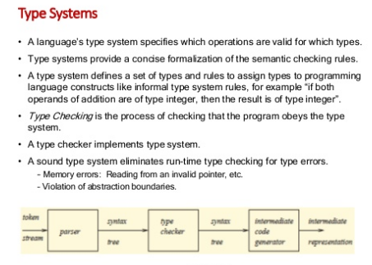
Type systems
A language’s type system specifies which operations are valid for which types.
Type systems provide a concise formalization of the semantic checking values.
Type checking is the process of checking that the program obeys the type system.
A type checker implements type system.
A sound type system eliminates run-time type checking for type errors.
Memory errors: Reading from an invalid pointer, etc.
Violation of abstraction boundaries.

Slide 4
Type checking
Means each operation in a program receives appropriate number of arguments of appropriate types in appropriate number.
Purpose is to verify that operations performed on a value are in-fact permissible.
Certain operations are legal for values of each type:
It does not make sense to add a function pointer and an integer in C.
It does make sense to add two integers.
The type of an identifier is typically available from declarations, but we may have to keep track of the type of intermediate expressions.
Type errors arise when operations performed on values that do not support that operation.

Slide 5
Type Checking Overview
Three kinds of languages:
Statically typed: All or almost all checking of types is done as part of compilation (C, C++).
Dynamically typed: Almost all checking of types is done as part of program execution (scheme, Prolog).
Untyped: No type checking (machine code).
Static typing
Static checking catches many programming errors at compiling time.
Avoids overhead of runtime type checks
Dynamic typing
Static type systems are restrictive
Rapid prototyping easier in a dynamic type system

Slide 6
Verification Vs Validation
Verification Are we building the product right
The software should conform to its specification
Validation Are we building the right product
The software should do what the user really requires

Slide 7
Dynamic and Static Verification
Dynamic V & V Concerned with exercising and observing product behavior (testing).
Static verification Concerned with analysis of the static system representation to discover problems.

Slide 8
Static and Dynamic V&V

